Slide 1
A GIFT OF FIRE THIRD EDITION - SARA BAASE
CHAPTER 2: PRIVACY
Lecture 4
"PROTECTING PRIVACY”
Syada Tasmia Alvi
Lecturer, Dept.of CSE
Daffodil International University

Slide 2
Technology and Markets:
Awareness:
Most people have figured out now you can’t do anything on the web without leaving a record.
We can decide to what extent we wish to use privacy-protecting tools.
We can be more careful about the information we give out, and the privacy policies of sites we use or visit.

Slide 3
Technology and Markets:
Privacy-enhancing technologies for consumers
New applications of technology often can solve problems that arise as side effects of technology.
Example: cookie disablers, blocking pop-up ads, scanning PCs for spyware, etc.
Using usernames and passwords for Blogs visitors (family , friends, etc.)
Notes:
Several companies provide services, called anonymizers, with which people can surf the Web anonymously, leaving no record that identifies them or their computers.
Some search engines do not store user search queries in a way that allows linking them.

Slide 4
Technology and Markets:
Encryption
Information sent to and from websites can be intercepted.
Someone who steals a computer or hacks into it can view files on it .
Encryption is a technology that transforms data into a form that that is meaningless to anyone who might intercept or view it.
Encryption generally includes a coding scheme, or cryptography algorithm, and specific sequences of characters (digits or letters).
Cryptography is the art and science of hiding data in plain sight.
—Larry Loen

Slide 5
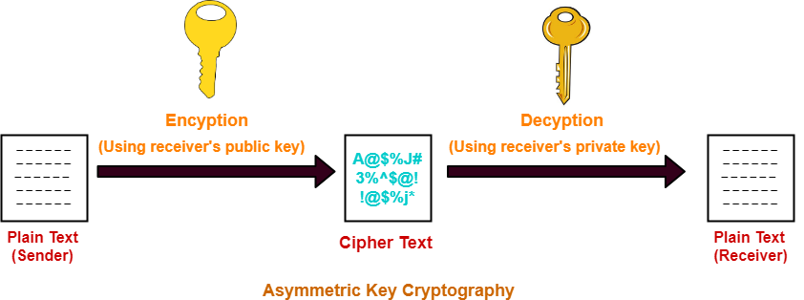
Technology and Markets:
Encryption
Public-key cryptography: An encryption scheme, where two related keys are used.
A key to encrypt messages.
A key to decrypt messages.

Slide 6
Technology and Markets:
Business tools and policies for protecting privacy
A well-designed database for sensitive information includes several features to protect against leaks, intruders, and unauthorized employee access.
Each person with authorized access to the system should have a unique identifier and a password.
A system can restrict users from performing certain operations, such as writing or deleting, on some files. User IDs can be coded so that they give access to only specific parts of a record.
For example, a billing clerk in a hospital does not need access to the results of a patient’s lab tests.

Slide 7
Technology and Markets:
Business tools and policies for protecting privacy
The computer system keeps track of information about each access, including the ID of the person looking at a record and the particular information viewed or modified. This is an audit trail that can later help trace unauthorized activity.
Website operators pay thousands, sometimes millions, of dollars to companies that do privacy audits. Privacy auditors check for leaks of information, review the company’s privacy policy and its compliance with that policy, evaluate warnings and explanations on its website that alert visitors when the site requests sensitive data, and so forth.
Some large companies like IBM and Microsoft, use their economic influence to improve consumer privacy on the web, by removing ads from their web sites.

Slide 8
Rights and laws:
Warren and Brandeis: The inviolate personality -
Warren and Brandeis criticized newspapers especially for the gossip columns.
People have the right to prohibit publications of facts (and photos) about themselves.
The kinds of information of most concern to them are personal appearance, statements, acts, and interpersonal relationships (marital, family, and others)
Warren and Brandeis say privacy is distinct and needs its own protection.

Slide 9
Rights and laws:
Thomson: Is there a right to privacy? -
Thomson argues the opposite point of view.
There is no violation of privacy without violation of some other right, such as the right to control our property or our person, the right to be free from violent attacks, the right to form contracts(and expect them to be enforced).
Notes:
If a person peacefully asks whom you live with or what your political views are, they have violated no rights. If you choose to answer and do not make a confidentiality agreement, the person is not violating your rights by repeating the information to someone else, though it could be inconsiderate to do so. However, if the person agreed not to repeat the information, but then does, it does not matter whether or not the information was sensitive; the person is violating the confidentiality agreement.

Slide 10
Rights and laws:
Applying the theories:
Many court decisions since Warren and Brandeis article, have taken their point of view.
A person may win a case if someone published his/her consumer profile.
Warren and Brandeis (and court decisions) allow disclosure of personal information to people who have an interest in it.
An important aspect: consent

Slide 11
Rights and laws:
Transactions
Privacy includes control of information about oneself.
How to apply privacy notions to transactions, Which involve more than one person?

Slide 12
Rights and laws:
Ownership of personal data
People should be given property rights in information about themselves.
But some activities and transactions involve at least two people, each of whom would have claims to own the information about the activity.
Can we own our profiles (collection of data describing our activities, purchase, interests, etc.) ?
We cannot own the fact that our eyes have a certain color

Slide 13
Rights and laws:
Regulation
Technical tools for privacy protection, market mechanisms, and business policies are not perfect.
Regulation is not perfect either.
Some Regulations may be so expensive and difficult to apply.
Example: Health Insurance Portability and Accountability Act (HIPAA)- protect sensitive patient health information from being disclosed without the patient’s consent or knowledge.

Slide 14
Rights and laws: Contrasting Viewpoints:
Free Market View
Freedom of consumers to make voluntary agreements
Diversity of individual tastes and values
Response of the market to consumer preferences
Usefulness of contracts

Slide 15
Rights and laws: Contrasting Viewpoints:
Consumer Protection View
Advocates of strong privacy regulation emphasize the unsettling uses of personal information
Costly and disruptive results of errors in databases
Ease with which personal information leaks out, via loss, theft, and carelessness
Consumers need protection from their own lack of knowledge, judgment, or interest

Slide 16
Communications
Wiretapping and Email Protection:
Telephone
1934 Communications Act prohibited interception of messages
1968 Omnibus Crime Control and Safe Streets Act allowed wiretapping and electronic surveillance by law-enforcement (with court order)

Slide 17
Communications
Wiretapping and Email Protection:
Electronic Communications Privacy Act of 1986 (ECPA) extended the 1968 wiretapping laws to include electronic communications, restricts government access to e-mail

Slide 18
Thank You

